Slide 1
Chapter 4: Intellectual Property

Slide 2
Chapter Overview (1/2)
Introduction
Intellectual property rights
Protecting intellectual property
Fair use
New restrictions on use

Slide 3
Chapter Overview (2/2)
Peer-to-peer networks
Protections for software
Open-source software
Legitimacy of intellectual property protection for software
Creative Commons

Slide 4
4.1 Introduction

Slide 5
Information Technology Changing Intellectual Property Landscape
Value of intellectual properties much greater than value of media
Creating first copy is costly
Duplicates cost almost nothing
Illegal copying pervasive
Internet allows copies to spread quickly and widely
In light of advances in information technology, how should we treat intellectual property?

Slide 6
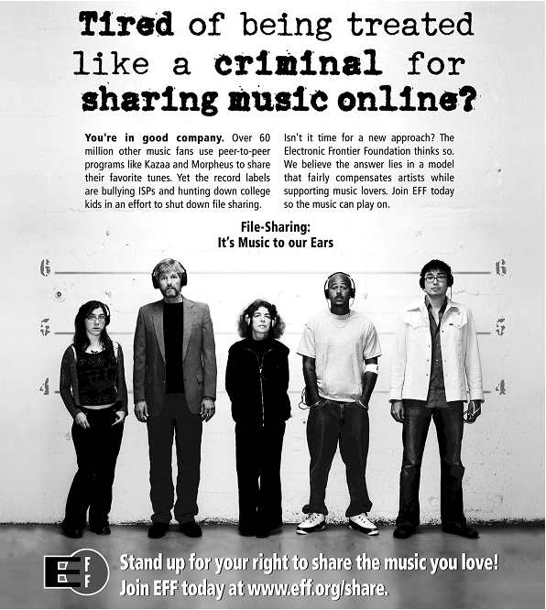
Reproduced by permission of Electronic Frontier Foundation via Creative Commons Attribution License 3.0. Go to www.eff.org/copyright for redistribution information. To access the original work, go to w2.eff.org/IP/P2P/?f=music-to-our-ears.html

Slide 7
4.2 Intellectual Property Rights

Slide 8
What Is Intellectual Property?
Intellectual property: any unique product of the human intellect that has commercial value
Books, songs, movies
Paintings, drawings
Inventions, chemical formulas, computer programs
Intellectual property ≠ physical manifestation

Slide 9
Property Rights
Locke: The Second Treatise of Government
People have a right…
to property in their own person
to their own labor
to things which they remove from Nature through their labor
As long as…
nobody claims more property than they can use
after someone removes something from common state, there is plenty left over

Slide 10
Locke’s Notion of Property Rights

Slide 11
Expanding the Argument to Intellectual Property
Writing a play akin to making a belt buckle
Belt buckle
Mine ore
Smelt it down
Cast it
Writing a play
“Mine” words from English language
“Smelt” them into prose
“Cast” them into a complete play

Slide 12
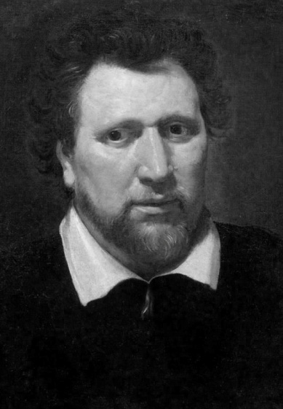
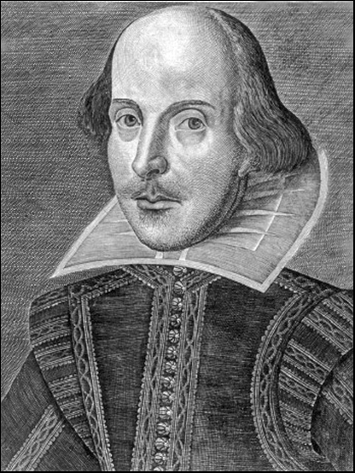
Analogy Is Imperfect
If Ben Jonson and William Shakespeare simultaneously write down Hamlet, who owns it?
If Ben “steals” the play from Will, both have it

Slide 13
Benefits of Intellectual Property Protection
Some people are altruistic; some are not
Allure of wealth can be an incentive for speculative work
Authors of U.S. Constitution recognized benefits to limited intellectual property protection

Slide 14
Limits to Intellectual Property Protection
Giving creators rights to their inventions stimulates creativity
Society benefits most when inventions in public domain
Congress has struck compromise by giving authors and inventors rights for a limited time

Slide 15
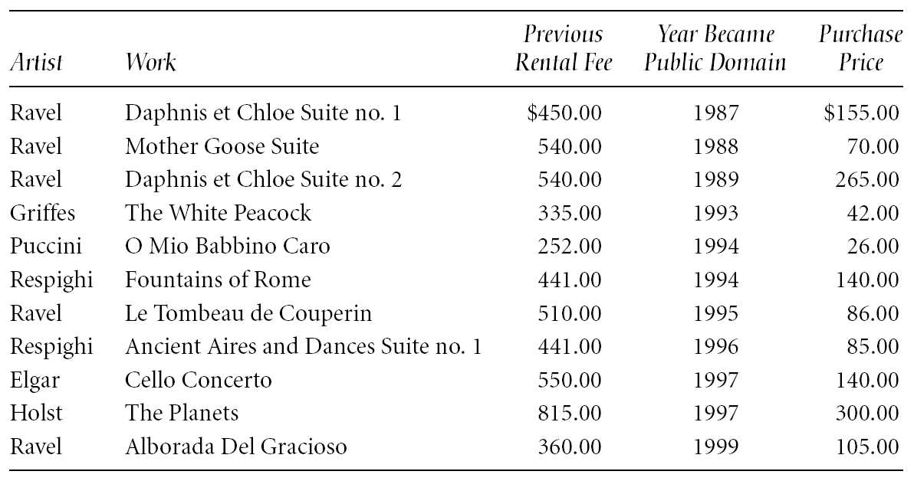
Prices Fall When Works Become Public Domain
Table from “Letter to The Honorable Senator Spencer Abraham,” by Randolph P. Luck from LUCK’S MUSIC LIBRARY. Copyright © 1996 by Randolph P. Luck. Reprinted with permission.

Slide 16
4.3 Protecting Intellectual Property

Slide 17
Trade Secret
Confidential piece of intellectual property that gives company a competitive advantage
Never expires
Not appropriate for all intellectual properties
Reverse engineering allowed
May be compromised when employees leave firm

Slide 18
Trademark, Service Mark
Trademark: Identifies goods
Service mark: Identifies services
Company can establish a “brand name”
Does not expire
If brand name becomes common noun, trademark may be lost
Companies advertise to protect their trademarks
Companies also protect trademarks by contacting those who misuse them

Slide 19
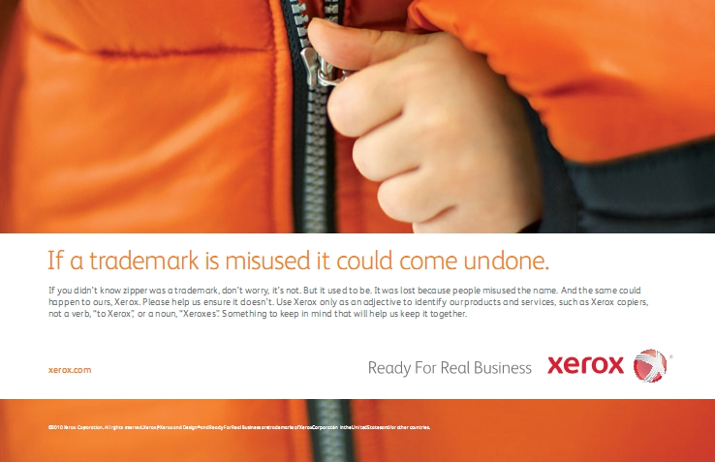
Screenshot by Xerox. Copyright © 2012 by Xerox Corporation. All rights reserved. Reprinted with permission.
Xerox Corporation ran this advertisement as part of its campaign to protect its trademark

Slide 20
Patent
A public document that provides detailed description of invention
Provides owner with exclusive right to the invention
Owner can prevent others from making, using, or selling invention for 20 years

Slide 21
Copyright
Provides owner of an original work five rights
Reproduction
Distribution
Public display
Public performance
Production of derivative works
Copyright-related industries represent 5% of U.S. gross domestic product (> $500 billion/yr)
Copyright protection has expanded greatly since 1790

Slide 22
Key Court Cases and Legislation (PP. 173-174)
Gershwin Publishing Corporation v. Columbia Artists Management, Inc.
Basic Books v. Kinko’s Graphics Corporation (Kinko needed to pay US$510,000 to a group of 8 publishers. Kinko got out of the “Professor Publishing” business)
Davey Jones Locker
No Electronic Theft Act (1994)

Slide 23

Copyright Creep
95
75
56
Years of Protection
Automatic renewal
42
Computer software
Motion pictures
28
Sound recordings
Photographs
Corporate authorship
Prints
Sheet music
A
ll literary works
Books
1790
1831
1909
1976
1998

Slide 24
Copyright Creep
Since 1790, protection for books extended from 28 years to 95 years or more
Some suggested latest extension done to prevent Disney characters from becoming public domain
Group of petitioners challenged the Copyright Term Extension Act of 1998, arguing Congress exceeded Constitutional power
U.S. Supreme Court (Copyright Term Extension Act)
CTEA does not create perpetual copyrights
CTEA is constitutional

Slide 25
4.4 Fair Use

Slide 26
Fair Use Concept
Sometimes legal to reproduce a copyrighted work without permission
Courts consider four factors
Purpose and character of use
Nature of work
Amount of work being copied
Affect on market for work

Slide 27
Sony v. Universal City Studios
Sony introduces Betamax VCR (1975)
People start time shifting TV shows
Movie studios sue Sony for copyright infringements
U.S. Supreme Court rules (5-4) that time shifting is fair use

Slide 28
Time Shifting

Slide 29
Digital Recording Technology
Copying from vinyl records to cassette tapes introduced hiss and distortions
Introduction of compact disc a boon for music industry
Cheaper to produce than vinyl records
Higher quality
Higher price ⇒ higher profits
BUT it’s possible to make a perfect copy of a CD

Slide 30
Audio Home Recording Act of 1992
Protects rights of consumers to make copies of analog or digital recordings for personal, noncommercial use
Backup copy
Give to family member
Digital audio recorders must incorporate Serial Copyright Management System (SCMS), so consumers can’t make a copy of a copy

Slide 31
RIAA v. Diamond Multimedia Systems
MP3 compression allows songs to be stored in 10% of the space, with little degradation
Diamond introduces Rio MP3 player (1998)
People start space shifting their music
RIAA starts legal action against Diamond for violation of the Audio Home Recording Act
U.S. Court of Appeals, 9th Circuit, affirms that space shifting is consistent with copyright law

Slide 32
Space Shifting

Slide 33
Kelly v. Arriba Soft Corporation (PP. 180-181)
Kelly: Photographer maintaining Web site with copyrighted photos
Arriba Soft: Creates search engine that returned thumbnail images
Kelly sues Arriba Soft for copyright infringement
U.S. Court of Appeals, 9th Circuit, affirms that use of images is a fair use

Slide 34
Google Books (PP. 181-183)
Google announced plan to scan millions of books held by several huge libraries, creating searchable database of all words
If public domain book, system returns PDF
If under copyright, user can see a few sentences; system provides links to libraries and online booksellers
Authors Guild and publishers sued Google for copyright infringement
Out-of-court settlement under review by U.S. District Court for Southern District of New York

Slide 35
Benefits of Proposed Settlement
Google would pay $125 million to resolve legal claims of authors and publishers and establish Book Rights Registry
Readers would have much easier access to out-of-print books at U.S. public libraries and university libraries
University libraries could purchase subscriptions giving their students access to collections of some of world’s greatest libraries
Authors and publishers would receive payments earned from online access of their books, plus share of advertising revenues

Slide 36
Criticisms of Proposed Settlement
Google should have gone to court
Google had a good case that its use was a fair use, based on precedent of Kelly v. Arriba Soft
If Google had been found not guilty of copyright infringement, it could have given public access to books at lower rates
Agreement gives Google a virtual monopoly over orphaned works
Potential chilling effect of Google tracking the pages that people are viewing

Slide 37
Court Rejects Proposed Settlement
March 2011: U.S. District Court for Southern District of New York rejected proposed settlement
Judge ruled agreement would have:
Given Google significant advantage over competitors
Rewarded Google for “wholesale copying of copyrighted words without permission”
Given Google liberal rights over orphaned works

Slide 38
4.5 New Restrictions on Use

Slide 39
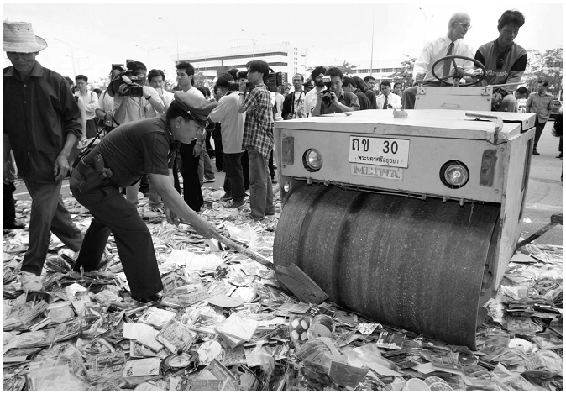
Counterfeit CDs Means Lost Profits
© Reuters/CORBIS

Slide 40
Digital Millennium Copyright Act
Passed by Congress in 1998
First big revision of copyright law since 1976
Brought U.S. into compliance with Europe
Extended length of copyright
Extended copyright protection to music broadcast over Internet
Made it illegal for anyone to
Circumvent encryption schemes placed on digital media
Circumvent copy controls, even for fair use purposes

Slide 41
Digital Rights Management
Actions owners of intellectual property take to protect their rights
Approaches
Encrypt digital content
Digital marking so devices can recognize content as copy-protected

Slide 42
Secure Digital Music Initiative (1998)
Goals
Create copy-protected CDs
Secure digital music downloads
Consortium of 200 companies developed “digital watermarking” scheme
Failed
Internet copying became huge before SDMI ready
Some SDMI sponsors were electronics companies
Digital watermarking encryption cracked (2000)

Slide 43
Sony BMG Music Entertainment Rootkit
Millions of audio CDs shipped with Extended Copy Protection, a DRM system
Prevented users from
Ripping audio tracks into MP3 format
Making more than 3 backup copies
Relied upon Windows “rootkit” that hid files and processes; usually only hackers use rootkits
Huge public outcry once secret uncovered
Sony BMG stopped production and compensated consumers

Slide 44
Encrypting DVDs (P. 186)
Contents of DVDs encrypted using Content Scramble System (CSS)
Need decryption keys to view a DVD
In 1999, Jon Johansen wrote a decryption program for Linux
2600 Magazine published the code
Motion picture studios sued 2600 Magazine and won
Johansen tried in Norway (2003) and found not guilty

Slide 45
Foiling HD-DVD Encryption (PP. 186-187)
Hardware, software, and entertainment companies created Advanced Access Content System to encrypt HD-DVDs
Encryption key posted on Digg.com (2007)
AACS leaned on Digg.com to censor postings containing key
Digg users fought back
AACS “expired” the key and issued a new one
A month later, a Digg user posted the new key

Slide 46
Criticisms of Digital Rights Management
Any technological “fix” is bound to fail
DRM undermines fair use
DRM could reduce competition
Some schemes make anonymous access impossible (Microsoft’s Windows Media Player keeps track of all the contents the user views)

Slide 47
Online Music Stores Employed Digital Rights Management
When iTunes Music Store opened in 2003, all music was protected with a DRM scheme called FairPlay
FairPlay blocked users from freely exchanging purchased music
Songs couldn’t be played on more than 5 different computers
Songs couldn’t be copied onto CDs more than 7 times
Songs purchased from iTunes Store wouldn’t play on non-Apple devices
DRM-protected music purchased from other online retailers couldn’t be played on iPod

Slide 48
Online Music Stores Drop Digital Rights Management
Consumers complained about restrictions associated with DRM
European governments put pressure on Apple to license FairPlay or stop using DRM
Amazon reached an agreement with all four major music labels (Universal Music Group, Sony BMG, Warner Music Group, & EMI) to sell DRM-free music
Apple followed suit in 2009

Slide 49
4.6 Peer-to-Peer Networks

Slide 50
Peer-to-Peer Networks Facilitate Data Exchange
Peer-to-peer network
Transient network
Connects computers running same networking program
Computers can access files stored on each other’s hard drives
How P2P networks facilitate data exchange
Give each user access to data stored in many other computers
Support simultaneous file transfers among arbitrary pairs of computers
Allow users to identify systems with faster file exchange speeds

Slide 51
A Peer-to-Peer Network
A peer-to-peer network connects computers running the same networking program. Computers can access files stored on each other’s hard drives.

Slide 52
Napster (P. 189)
Peer-to-peer music exchange network
Began operation in 1999
Sued by RIAA for copyright violations
Courts ruled in favor of RIAA
Went off-line in July 2001
Re-emerged in 2003 as a subscription music service

Slide 53
FastTrack (P. 189)
Second-generation peer-to-peer network technology introduced in 2001
Used by KaZaA and Grokster
Distributes index among large number of “supernodes”
Cannot be shut down as easily as Napster

Slide 54
Comparing Napster and FastTrack
In Napster, a central server maintains the index of all files available for sharing. Retrieving a file in 3 steps: (1) make the request to the central server, (2) establish a connection between the sending & receiving computers, (3) transfer the file.
In FastTrack, the index of available files is distributed among many “supernodes”. Each supernode has information about available files on “nearby” computers. Different users connect with different supernodes.

Slide 55
BitTorrent
Broadband connections: download much faster than upload
BitTorrent speeds downloading
Files broken into pieces
Different pieces downloaded from different computers
Used for downloading large files
Computer programs
Television shows
Movies

Slide 56
Concept Behind BitTorrent
Broadband Internet connections provide higher speeds for downloading than for uploading.
BitTorrent reduces downloading timed by enabling a computer to download different pieces of a file simultaneously from many different peers.

Slide 57
RIAA Lawsuits (PP. 190-192)
April 2003: RIAA warned file swappers they could face legal penalties
RIAA subpoenaed Verizon for identities of people suspected of running supernodes
Judge ruled in favor of RIAA
September 2003: RIAA sued 261 individuals
December 2003: U.S. Court of Appeals ruled Verizon did not have to give customer names to RIAA

Slide 58
Huge Jury Judgments Overturned
Jammie Thomas-Rassert
Federal jury ordered her to pay $1.92 million
Damages reduced to $54,000
Joel Tenenbaum
Jury ordered him to pay $675,000
Judge reduced award to $67,500
Does RIAA have to prove someone actually copied the songs that people made available on Kazaa?
New York decision: No
Massachusetts, Arizona decisions: Yes

Slide 59
MGM v. Grokster (PP. 192-194)
Entertainment industry interests sued Grokster and StreamCast for the copyright infringements of their users
Lower courts
Granted Grokster and StreamCast a summary judgement
Cited Sony v. Universal City Studios as a precedent
U.S. Supreme Court
Reversed the lower court ruling in June 2005
Proper precedent Gershwin Publishing Corporation v. Columbia Artists Management

Slide 60
Legal Action Against The Pirate Bay
The Pirate Bay located in Stockholm, Sweden
One of world’s biggest BitTorrent file-sharing sites
People download songs, movies, TV shows, etc.
After 2006 raid by police, popularity increased
In 2008 the International Federation of the Phonographic Industry sued four individuals connected with site
Defendants said The Pirate Bay just a search engine
Found guilty; sentence to prison and fined $6.5 million
Meanwhile, The Pirate Bay still operational

Slide 61
Legal Music Services on the Internet
Subscription services for legal downloading
Some based on monthly fee; some free
Consumers pay for each download
Apple’s iTunes Music Store leading service, surpassing WalMart as top music retailer in United States
Still, illegal downloading far more popular than legal music services

Slide 62
4.7 Protections for Software

Slide 63
Software Copyrights
Copyright protection began 1964
What gets copyrighted?
Expression of idea, not idea itself
Object program, not source program
Companies treat source code as a trade secret

Slide 64
Violations of Software Copyrights
Copying a program to give or sell to someone else
Preloading a program onto the hard disk of a computer being sold
Distributing a program over the Internet

Slide 65
Important Court Cases (P. 196)
Apple Computer v. Franklin Computer
Established that object programs are copyrightable
Sega v. Accolade
Established that disassembling object code to determine technical specifications is fair use

Slide 66
Software Patents (1/3)
Until 1981, Patent Office refused to grant software patents
Saw programs as mathematical algorithms, not processes or machines
U.S. Supreme Court decision led to first software patent in 1981 (PP. 196-197)
Further court rulings led to patents being granted for wider range of software

Slide 67
Software Patents (2/3)
Thousands of software patents now exist
Microsoft files ~3,000 applications annually
Licensing patents a source of revenue
Secondary market for software patents
Patent trolls: Companies that specialize in buying patents and enforcing patent rights (P.197)
Companies would rather settle out of court than spend time and money going to trial
RIM didn’t settle quickly; ended up paying $612 million

Slide 68
Software Patents (3/3)
Critics say too many patents have been issued
Patent Office doesn’t know about prior art, so it issues bad software patents
Obvious inventions get patents
Companies with new products fear getting sued for patent infringement
Build stockpiles of patents as defense mechanism
Software patents used as legal weapons
Bezos: software patents should expire in 3-5 years

Slide 69
Safe Software Development
Reverse engineering okay
Companies must protect against unconscious copying
Solution: “clean room” software development strategy
Team 1 analyzes competitor’s program and writes specification
Team 2 uses specification to develop software

Slide 70
4.8 Open-Source Software

Slide 71
Consequences of Proprietary Software
Increasingly harsh measures being taken to enforce copyrights
Copyrights are not serving their purpose of promoting progress
It is wrong to allow someone to “own” a piece of intellectual property

Slide 72
Open-Source Definition
No restrictions preventing others from selling or giving away software
Source code included in distribution
No restrictions preventing others from modifying source code
No restrictions regarding how people can use software
Same rights apply to everyone receiving redistributions of the software (copyleft)

Slide 73
Beneficial Consequences of Open-Source Software
Gives everyone opportunity to improve program
New versions of programs appear more frequently
Eliminates tension between obeying law and helping others
Programs belong to entire community
Shifts focus from manufacturing to service

Slide 74
Examples of Open-Source Software
BIND
Apache
Sendmail
Android operating system for smartphones
Firefox
OpenOffice.org
Perl, Python, Ruby, TCL/TK, PHP, Zope
GNU compilers for C, C++, Objective-C, Fortran, Java, and Ada

Slide 75
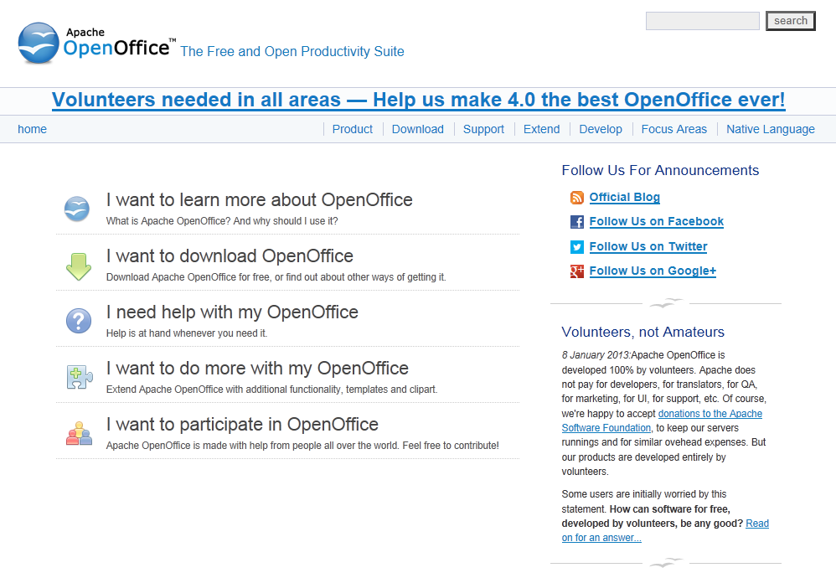

Slide 76
GNU Project and Linux
GNU Project
Begun by Richard Stallman in 1984
Goal: Develop open-source, Unix-like operating system
Most components developed in late 1980s
Linux
Linus Torvalds wrote Unix-like kernel in 1991
Combined with GNU components to make an O.S.
Commonly called Linux

Slide 77
Impact of Open-Source Software
Linux putting pressure on companies selling proprietary versions of Unix
Linux putting pressure on Microsoft and Apple desktops

Slide 78
Crititique of the Open-Source Software Movement
Without critical mass of developers, quality can be poor
Without an “owner,” incompatible versions may arise
Relatively weak graphical user interface
Poor mechanism for stimulating innovation (no companies will spend billions on new programs)

Slide 79
4.9 Legitimacy of Intellectual Property Protection for Software

Slide 80
Do We Have the Right System in Place?
Software licenses typically prevent you from making copies of software to sell or give away
Software licenses are legal agreements
Not discussing morality of breaking the law
Discussing whether society should give intellectual property protection to software

Slide 81
Rights-based Analysis (PP. 204-205)
“Just deserts” argument
Programming is hard work that only a few can do
Programmers should be rewarded for their labor
They ought to be able to own their programs
Criticism of “just deserts” argument
Why does labor imply ownership?
Can imagine a just society in which all labor went to common good
Intellectual property not like physical property

Slide 82
A Consequentialist Argument Why Software Copying Is Bad
Beth Anderson

Slide 83
Utilitarian Analysis
Argument against copying
Copying software reduces software purchases…
Leading to less income for software makers…
Leading to lower production of new software…
Leading to fewer benefits to society
Each of these claims can be debated
Not all who get free copies can afford to buy software
Open-source movement demonstrates many people are willing to donate their software-writing skills
Hardware industry wants to stimulate software industry
Difficult to quantify how much society would be harmed if certain software packages not released

Slide 84
Conclusion
Natural rights argument weak
Utilitarian argument not strong, either
Nevertheless, society has granted copyright protection to owners of computer programs
Breaking the law is wrong unless there is a strong overriding moral obligation or consequence

Slide 85
4.10 Creative Commons

Slide 86
Streamlining Creative Re-use
Under current copyright law, eligible works are copyrighted the moment they are created
No copyright notice does not mean it’s okay to copy
Must contact people before using work
That slows down creative re-use
Free Creative Commons license indicates
Which kinds of copying are okay
Which rights are being retained
Flickr and Magnatune two well-known sites using Creative Commons licenses

Slide 87
